Slide 1
Hands on with bootstrap

Slide 2
WHAT IS BOOTSTRAP ?
Bootstrap is a popular HTML,Css and Javascript framework for developing a responsive and mobile friendly website.
Bootstrap is Free and open source

Slide 3
Steps to add Bootstrap to Html :-
Search bootstrap on google and open the first link which will be highlighted as getbootstrap.com .
You can add the bootstrap to your website using different methods .

Slide 4
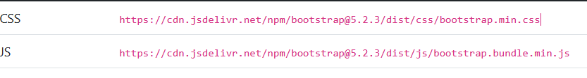
By Copying the CDN link :-
You can get this link from getbootstrap.com

Slide 5
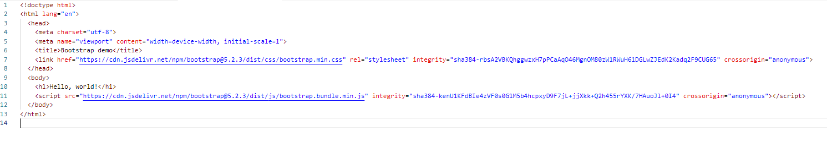
By copying the in your HTML file :-
You can get this html file from getbootstrap.com

Slide 6
Bootstrap Grid System.
Bootstrap grids allow to structure the layout that are mobile friendly too.

Slide 7
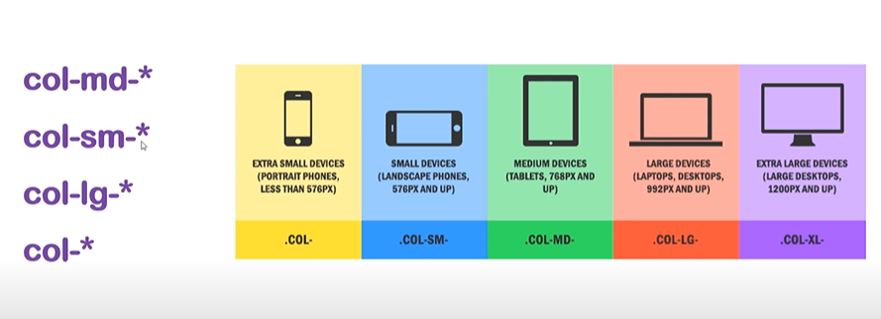
Bootstrap's grid system allows up to 12 columns across the page.If you do not want to use all 12 column individually, you can group the columns together to create wider columns:
The Bootstrap grid system has four classes:
xs (for phones - screens less than 768px wide)
sm (for tablets - screens equal to or greater than 768px wide)
md (for small laptops - screens equal to or greater than 992px wide)
lg (for laptops and desktops - screens equal to or greater than 1200px wide)
The classes above can be combined to create more dynamic and flexible layouts.

Slide 8
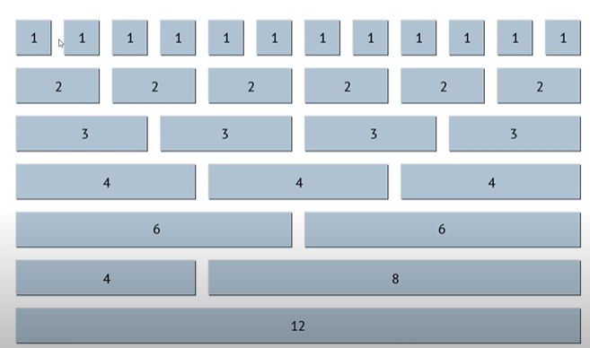

Slide 9
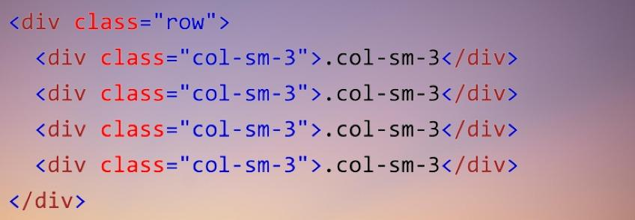
Bootstrap Grid Examples

Slide 10
Bootstrap classes
Bootstrap provides in-built defined classes which can be used for styling .
Click on the given link to see the full list of bootstrap classes.
https://getbootstrap.com/docs/3.3/css/

Slide 11
Classes that are used frequently are :-
Typography :- The elements below are HTML elements that will be styled a little bit differently by Bootstrap than browser defaults.
The classes below is used to style the elements further.
Button Classes :- The button classes can be used to style any <a>, <button>, or <input> element.
Form Classes :- The form classes can be used to style and add different elements of form.

Slide 12
NAVBAR

Slide 13
Header background and customising it

Slide 14
Learning to use fonts

